Slide 1

AD 599S B1 Final Project
The Northwind Project:
Predictive Analytics & Strategic Insights
Presented by: Hung Trung Nguyen

Slide 2
AGENDA
Project Overview
Stakeholder Recap
Data Methodology
Analytical Insights
Predictive & Segmentation Models
Strategic Recommendations
Lessons Learned & Next Steps
Q&A + Feedback
Notes:
- Setting the stage: goals, tools, and stakeholder focus
- The strategic roles and their business challenges
How we integrated SQL and Python to extract insights
Key findings: employees, sales trends, products, and customers
ARIMA forecasting and K-Means customer clustering
Action plans tailored to each stakeholder
Limitations, improvements, and future applications
Open for questions and post-review adjustments

Slide 3

WHO
WHAT
WHEN
WHERE
HOW
WHY
Notes:
Before diving into the details of our project, I want to pause and reflect on the intelligence behind the analysis. This slide represents the thinking architecture I followed — every data-driven decision we made started with a question.”
“WHO are we solving for?
WHAT are their challenges?
WHEN and WHERE do those challenges occur?
HOW did we build the solutions?
And most importantly — WHY does it matter?”
“This mental framework kept the project focused, logical, and strategic. By feeding these questions into our analytical engine — represented here by the brain — we ensured our work not only produced insights, but delivered real business intelligence.”
“So as we move forward, I’ll walk through each of these questions and show how they shaped my approach and empowered the stakeholders at Northwind.”

Slide 4

WHO are the stakeholders ?
💼 Marketing Campaign Strategist
Designs and executes promotions, seasonal campaigns, and product bundles
Aligns marketing efforts with high-performing products and sales peaks
Seeks to maximize ROI through timely, data-informed campaigns
🌐 E-commerce Personalization Lead
Manages digital engagement across web, email, and mobile
Customizes shopping experiences through recommendations and A/B testing
Focuses on boosting customer loyalty and conversion
Notes:
This project targets two high-leverage roles at Northwind.
First, the Marketing Campaign Strategist, who needs data to decide when to launch promotions and what to feature.
Second, the E-commerce Personalization Lead depends on customer insights to design personalized journeys that drive loyalty and sales.

Slide 5



WHAT are the business questions?
Which customers spend the most—and how do their behaviors differ?
How can we segment customers to deliver personalized messaging at scale?
What kind of product recommendations or re-engagement tactics will maximize loyalty?
When do our sales naturally peak, and how can we time promotions to amplify them?
Which products consistently drive revenue within each category?
How do we balance seasonal promotions with long-term product strategy?
Notes:
In this project, we didn’t just ask what data is available—we asked what questions our stakeholders urgently need answered.
For the strategist, it’s about timing, prioritizing SKUs, and synchronizing campaigns with demand.
For the personalization lead, it’s about understanding who buys, how they buy, and how we can nudge them to stay longer and spend more.

Slide 6

HOW ?
🧰 Integrated SQL + Python Workflow
All queries executed directly in Python using SQLite
Clean data pipeline enabled seamless transformation and analysis
📦 Key Python Libraries Used
Pandas, Polars: fast, efficient data manipulation
Plotly, Seaborn: interactive & insightful visualizations
statsmodels: ARIMA time-series forecasting
sklearn: K-Means clustering with PCA dimensionality reduction
🧱 Custom Feature Tables
Monthly_Sales_Features: monthly revenue for time-series prediction
Customer_RFM_Features: recency, frequency, monetary value for clustering
🤖 Machine Learning Applications
ARIMA to forecast monthly sales for the next 12 months
K-Means to segment customers into 4 behavioral clusters
Notes:
HOW did we build the solution ?
This analysis was built using SQL and Python in tandem — a combination that gave us both control and flexibility.
We crafted custom SQL feature tables, manipulated data using Polars and Pandas, then applied powerful models to generate forward-looking insights.
Whether it’s forecasting sales or understanding customer personas, each model was chosen with a stakeholder’s goal in mind.

Slide 7
WHERE + WHEN Did the Insights Occur?
📍 WHERE: Across Northwind’s Sales Ecosystem
Database Source:
All data was extracted from Northwind’s SQLite relational database, spanning orders, customers, employees, products, and order details.
Organizational Scope:
  🌎 Regional operations for employee and product performance
  🏬 E-commerce platform for customer behavior and personalization
  🧾 Order management system for forecasting and segmentation
Notes:
All of our analyses were rooted in the Northwind SQLite database, which houses over 90,000 records across orders, customers, employees, and products. These records span a robust timeline from July 2012 to October 2023, offering over a decade of sales activity across different channels.”
“On the ‘where’ side, our insights touch every part of the sales ecosystem—from internal performance reviews for the regional sales team, to e-commerce strategies driven by customer behavior.”

Slide 8
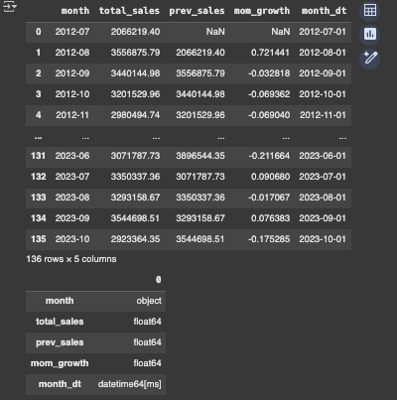
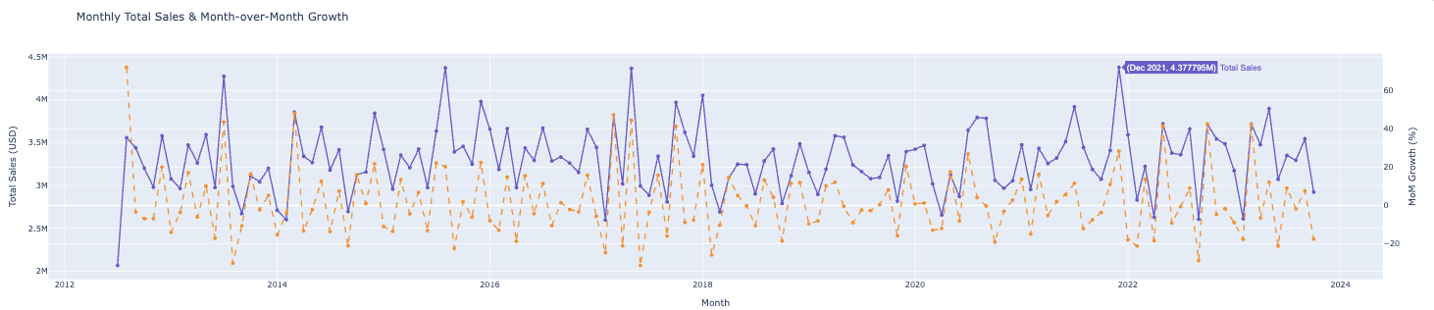
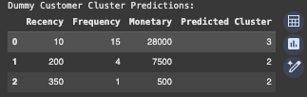

WHEN ?
🕒 WHEN: 2012–2023 Sales Timeline
Date Range: July 2012 → October 2023
Temporal Focus:
  ✅ Monthly trends over 11 years
  ✅ Forecasts for the next 03 months (ARIMA)
  ✅ Recency analysis for customer segmentation
Key Seasonal Insights:
  📈 Peaks: March, July, and December
  📉 Dips: February and October
Notes:
“On the ‘when’ side, temporal trends were key. Our monthly sales analysis showed predictable seasonality, with spikes in March, July, and December, and consistent downturns in February and October. These trends not only informed our time-series forecasting model but also helped define when marketing efforts should ramp up or cool down.”
“We extended this view forward using ARIMA forecasting to project the next 12 months. That gave us both a view of the past and foresight into what’s coming next.

Slide 9
WHY it matters ?
✅ Drive Revenue with Data
→ Align campaigns with seasonal patterns and sales forecasts.
✅ Serve the Right Customer, the Right Way
→ Segment-based outreach: Champions, Potentials, Newcomers, At-Risk.
✅ Boost Marketing ROI
→ Promote during high-performing periods to maximize efficiency.
✅ Inventory Meets Intelligence
→ Stock what sells. Bundle what lags. Plan smarter.
✅ Real-Time Decision Support
→ SQL + Python + ML = fast, informed, and flexible strategy.
Notes:
Why does this all matter? Because for Northwind, data isn't just a byproduct — it's a growth engine.
Our insights allow the Marketing Strategist to promote the right products at the right time, maximizing revenue without cannibalizing margins.
Meanwhile, the E-commerce Personalization Lead can use our customer segments to speak directly to each persona—whether it's winning back “At-Risk” buyers or upselling to “Champions.”
On top of that, by knowing which SKUs drive sales and when demand peaks, we’re enabling smarter inventory decisions. No more stockouts in March. No more overstock in October.
And thanks to our integration of SQL + Python + ML + dashboards, these aren’t just static charts—they’re tools for real-time decision-making.

Slide 10
Marketing Campaign Strategist
🟢 Data-Driven Solutions
ARIMA forecasting in Part 5 uncovers future peaks and variability windows
Monthly sales trends in Part 2 highlight March, July, and December as high-impact months
Product rankings by category in Part 3 help determine which SKUs to push and which to pair
Insights translate into a promotional calendar backed by real data
🔴 Challenges
Seasonal demand is difficult to predict, leading to missed promotional opportunities.
Campaigns are launched reactively, not proactively
No clear system to prioritize SKUs for discounting or bundling
Notes:
“The Marketing Strategist is always racing against time—without predictive signals, campaigns become reactive.”
“We helped solve this by identifying seasonal peaks with ARIMA and reinforcing them with historical trend data.”
“Instead of relying on gut feeling or last year’s campaign dates, we’ve built a data-backed playbook that says what to promote and when.”
“Plus, the customer’s category rankings allow smarter bundling, so that even slower SKUs can ride the wave of top performers.”

Slide 11
E-commerce Personalization Lead
🔴 Challenges
Limited ability to personalize offers by behavior
Hard to distinguish VIPs from one-time buyers
No clear segmentation for targeting re-engagement or loyalty programs
🟢 Data-Driven Solutions
Average Order Value rankings isolate top spenders from mid-tier customers.
K-Means Clustering using RFM produces 4 distinct personas:
→ Champions, Loyal Potentials, New Arrivals, At-Risk
PCA + scatterplots reveal actionable groupings for campaign design
Every customer can now be addressed with a tailored communication strategy
Notes:
“The Personalization Lead needs more than just names—they need personas.”
“We addressed this by clustering over 830 customers using Recency, Frequency, and Monetary value.”
“This gave us four crystal-clear segments, each with its own message, timing, and campaign need.”
“The result is smarter outreach – the loyal customers get VIP perks, existing customers get win-back offers, and new one get nudged toward repeat purchases.”

Slide 12
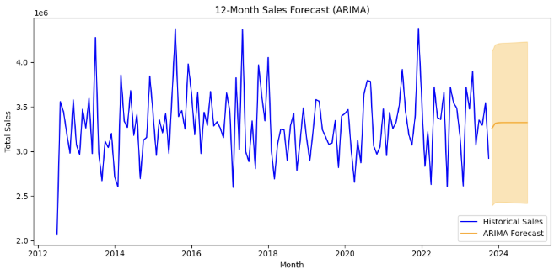
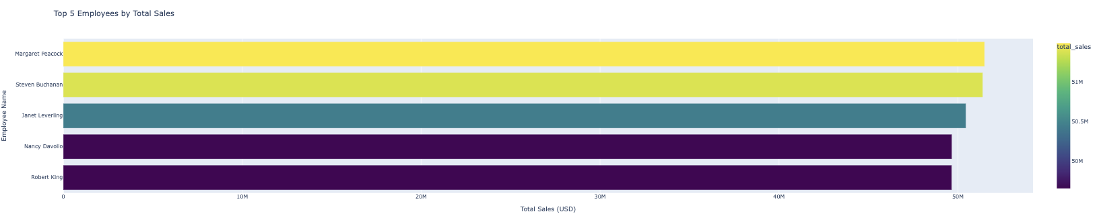
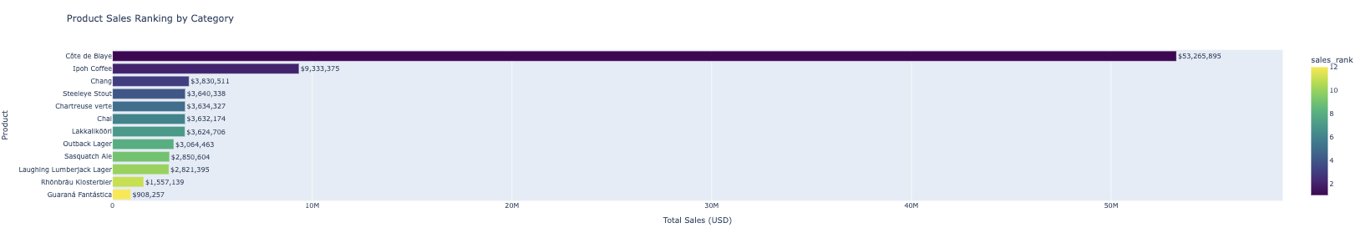
Key Insights ?
📈 Sales Forecast (ARIMA)
🔢 Employee Leaderboard Bar Chart
📊 Product Sales by Category
Notes:
“This slide brings together the most actionable insights from our full SQL + Python pipeline.”
“We begin with the ARIMA forecast, which maps demand fluctuations with confidence intervals—a game-changer for planning.” + Future peaks expected in March, July, and December; confidence bands highlight volatility mid-year.
“Our employee leaderboard gives the Sales Director clarity on who’s excelling and who’s just a few deals away from the top.” + Margaret Peacock leads, but the sales margin is narrow across the top 5—coaching can shift rankings.
“The product ranking analysis revealed not only the bestsellers but the untapped potential of mid-tier SKUs.” + Ipoh Coffee dominates Beverages; mid-ranked SKUs offer bundling potential.

Slide 13
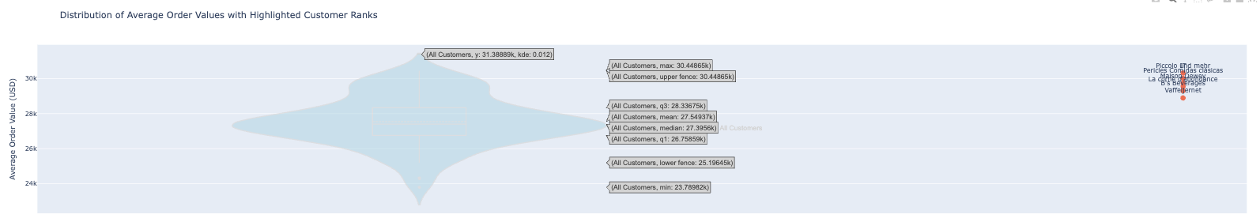
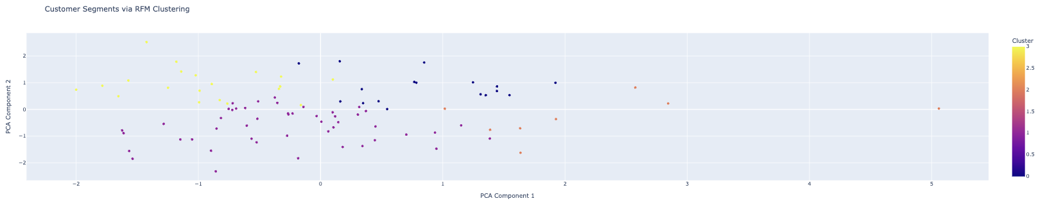

🎯 Violin Plot – Avg Order Value
🧬 K-Means Clustering (PCA)
Notes:
“The violin plot gave the Personalization Lead a laser-focused view of customer spending behavior.” + High-value customers clearly stand out—ideal for personalization and loyalty campaigns.
“Finally, the PCA-based clustering showed us where every customer sits—this insight powers customized outreach across the board.” + 4 customer personas identified—Champions, Loyal Potentials, New Arrivals, At-Risk.

Slide 14
Recommendations
Marketing Campaign Strategist
E-commerce Personalization Lead
📌 Data-Backed Campaign Timing
Leverage ARIMA forecasts to lock Q1–Q2 sales targets
Align promotions with historical peaks in March, July, December
📌 Promote What Works
Prioritize top SKUs like Ipoh Coffee and Northwoods Cranberry Sauce
Bundle high-performers with slower-moving items
📌 Avoid Revenue Gaps
Plan flash sales in low-performing months (e.g., February, October)
Use violin-plot segments to time promos for mid-tier spenders
📌 Stay Agile with Dashboards
Use interactive visuals to explore "what-if" scenarios
Monitor real-time campaign performance and adjust in-flight
📌 Segment Customers with Precision
Use K-Means personas: Champions, Loyal Potentials, New Arrivals, At-Risk
Deploy tailored messaging by cluster
📌 Personalize the Experience
Offer VIP perks and previews for Champions
Create frequency incentives for Loyal Potentials
Onboard New Arrivals with curated guides
Launch win-back campaigns for At-Risk users
📌 Use Behavior to Drive Revenue
Leverage average order values to identify upsell targets
A/B test offers per cluster to maximize conversion
📌 Integrate Seamlessly
Connect clustering output to recommendation engines
Feedback engagement data for continuous model training
Notes:
Marketing Strategist:
“For the Campaign Strategist, timing is everything. The ARIMA forecast lets them plan with statistical confidence.”
“By using category leaders like Ipoh Coffee as anchors, they can increase the velocity of underperforming SKUs through bundling.”
“Promotions shouldn't just fill gaps—they should build habits. That's why our violin analysis helps target high-potential mid-tier customers before they churn.”
“Finally, these insights don’t sit in static reports. Interactive dashboards let them pivot based on real-time feedback.”
E-Comm:
Our RFM clustering gives the Personalization Lead a GPS for every customer. From VIPs to At-Risk accounts, there’s a playbook for each.”
“We go beyond segmentation—each cluster comes with an outreach plan: incentives, content, and timing.”
“By marrying customer behavior with model outputs, the Personalization Lead can boost loyalty, repeat orders, and overall lifetime value.”
“And with feedback loops, this isn’t a one-time insight—it becomes part of an ongoing personalization engine.”

Slide 15
FUTURE OPPORTUNITIES
📌 Expand Predictive Modeling
Explore Prophet for multi-seasonal forecasting
Compare models (ARIMA vs. Prophet vs. ensemble)
📌 Dashboard Integration
Build real-time dashboards using Plotly Dash or Streamlit
Enable live filtering, drill-downs, and alert systems
📌 Personalization at Scale
Link clustering results with Northwind’s CRM/email engine
Implement automated A/B testing pipelines per customer group
📌 Recommendation Systems
Move toward collaborative filtering or content-based models
Suggest products dynamically based on past orders
📌 Business Rule Automation
Translate data insights into rules for promotions, inventory, and customer loyalty
Notes:
“We’ve laid the foundation—but Northwind can go even further.”
“By introducing Prophet, we can capture multiple seasonalities, like holiday surges and mid-year promotions.”
“Live dashboards make insights instantly actionable—letting decision-makers steer the business in real-time.”
“And imagine if product recommendations updated themselves based on real purchase behavior. That’s where collaborative filtering comes in.”
“Ultimately, we’re moving toward an ecosystem where strategy, automation, and personalization work hand-in-hand.”

Slide 16


THANK YOU <3

Slide 17
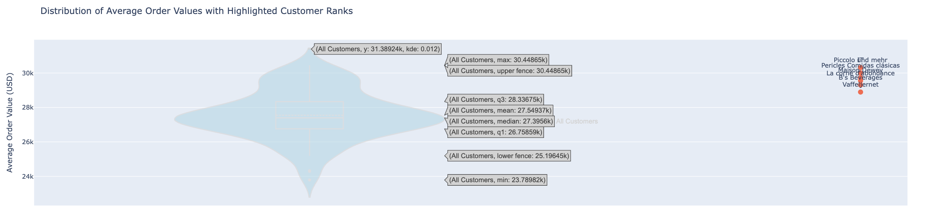
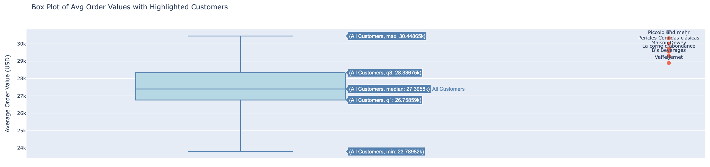
VIOLIN PLOT
BOX PLOT

Slide 18
Why Does the Violin Plot Look Different from the Box Plot?
Both the violin plot and box plot use the exact same dataset, and they display the same core statistics:
  Median: ~$27.4K
  Quartiles (Q1–Q3): ~$26.76K to ~$28.34K
  Min/Max: ~$23.79K to ~$30.45K
What makes the violin plot different is the added “shape”:
  It includes a kernel density estimate (KDE) — this shows the distribution of values across the range.
  The width of the violin at any point indicates the number of customers with average order values near that point.
    Wide center? Many customers near that value.
    Narrow tail? Few customers at that extreme.
  So visually, it reveals where the data is concentrated, unlike the box plot, which only shows summary percentiles.
Why it matters:
  The violin plot helps understand behavior and detect skewness or multimodality.
  In your case, it shows that most customers cluster tightly between $27K–$28K, with a few higher and lower outliers — especially relevant for segmentation and targeting.

